Slide 1
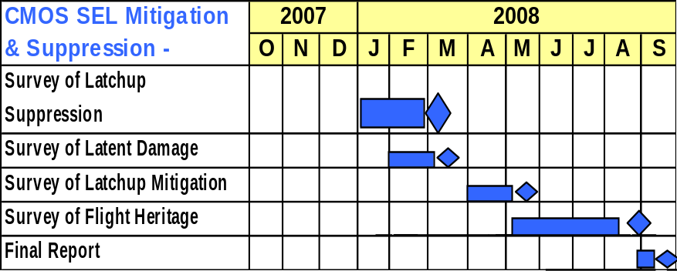
Single Event Latchup Risk Mitigation Trade Analysis
(New)
Rad-21
Description:
FY08 Plans:
  Phase I :
  Survey classes of SEL latent damage prevention and suppression/mitigation techniques available in literature
  Phase II:
  Document flight instances where such techniques were used
  Phase III:
  Develop guidelines for appropriate and effective use of each technique
  This task will be leveraging off various JPL projects’ funded testing.
  Technical collaboration is planned with Maxwell Technologies using their mitigation technology (Custom ASIC-based).
In a continuing trend, more state-of-the-art commercial CMOS or BiCMOS (digital and mixed signal) products are selected by flight designers for critical flight applications, but many of these components suffer from susceptibility to single-event latchup. Common examples include analog-to-digital convertors (ADCs) and high density dynamic RAMs.
An SEL may create local voids in metallization or contacts regions that do not result in failure, but degrade reliability because the metallization has only a small fraction of its normal cross sectional area. The voids are caused by ejected metal from severe localized heating during latchup. This effect is known as “Latent Damage” and is an important concern for SEL sensitive devices used in space.
This task aims to reduce the risk of flying parts with destructive latchup susceptibility and focuses on SEL suppression/mitigation techniques and possibilities of preventing Latent Damage. This task consist of developing a trade space matrix and guidelines for appropriate application of available latchup mitigation and suppression techniques.
Schedule/Costs:
Total Full-Cost = $ (estimated)
Deliverables:
  Quarterly status reporting
  Interim report due in June 2008
  Handbook of SEL Suppression and Mitigation Techniques: Tradeoffs and Guideline for Flight Designers
NASA and Non-NASA Organizations/Procurements:
Lead Center/PI: JPL, M. Elghefari
Co-Is: L. Scheick
Contributors: Maxwell, P. Layton
Center Funding Split:
Various JPL projects
Maxwell Technologies

